Slide 1

Lesson: 3.01 Built in Functions
Microsoft Philanthropies TEALS Program
Introduction to Computer Science
Semester 2

Slide 2
Built in Functions
After this lesson, you will be able to...
Define and identify function, arguments, calling, importing, returning
Call the built-in randint function, using arguments
Utilize code other people have written in the Python documentation
Understand the difference between printing and returning

Slide 3
Today’s Plan
Do Now
Lesson
Lab
Debrief

Slide 4
Do Now
Write down in your notebook ONE thing you learned yesterday in class?
Type the following code into the editor and run the program.
import random
random.randint(0, 3)
random.randint(0, 3)
print(random.randint(0, 3))
print(random.randint(0, 3))
print(random.randint(0, 3))
What does randint do?
What do the values 0 and 3 do?
Try changing those numbers, rerun the program, and write down what changed.
What is the difference between random.randint(0,3) and print(random.randint(0,3))?
Notes:
Give students 3-4 minutes to follow the instructions on the Do Now page.
Debrief the answers to the questions on the Do Now by calling on students to respond.

Slide 5
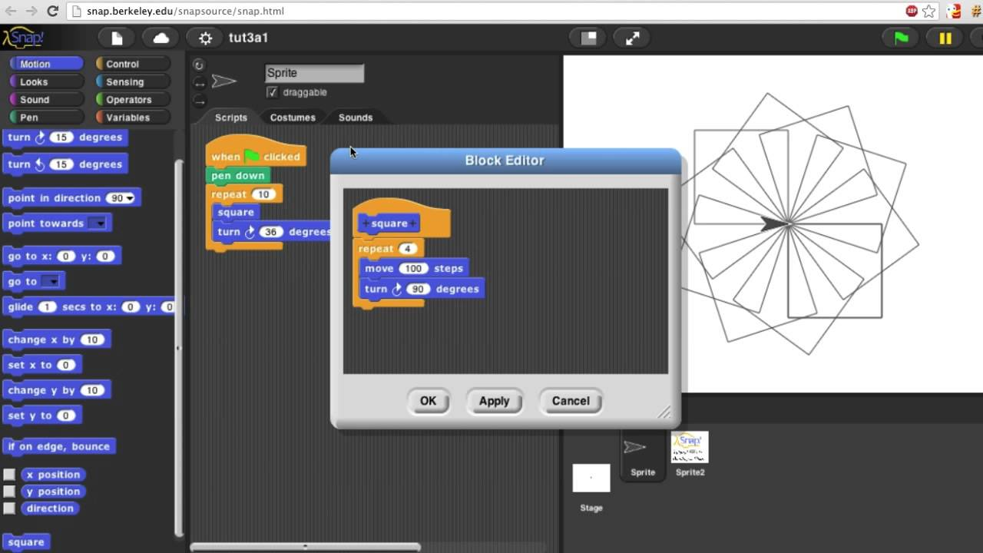
Remember – Building your own block in Snap
Notes:
Remind students of creating a block in Snap!

Slide 6
Function
Definition: A named sequence of statements.
You can “call” the function by its function name.
Expect a set of arguments defined by whoever designed them
How to determine what the arguments are? Documentation
To find the documentation for Python, you can search on your favorite search engine.
What are some built in functions we’ve seen?
print()
type()
randint()
Notes:
You can use functions to perform complex calculations, graphical operations, and various other purposes. When you define a function, you specify the name and the sequence of statements.
You tell the programmer what elements the function expects (name and type of arguments) and the function will perform its purpose. It is good practice to use a comment to specify the purpose and contract of a function, including the type of value it returns, if it returns a value.

Slide 7
Parts of a function written in Python
x = somefunction(a, b, c)
Returned value is saved to x
Name of the Function
Arguments
Notes:
Talk about the different components of a function.

Slide 8
How to get a random integer: randint(0, 10)
In your notebook, Write the following chunk of code:
x = randint(0,10)
Print(x)
Write down what the code output from this in your notebook,
Notes:
Teacher – Ask for volunteers to share their answers.
Answers should be integers between 0 and 10

Slide 9
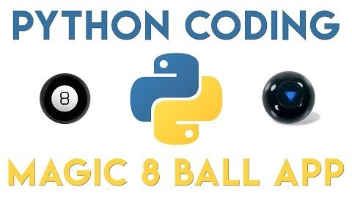
Lab 3.01 – What is the Magic 8 Ball?
Notes:
Lab 03.01 - https://tealsk12.gitbook.io/intro-cs-2/unit_3/lesson/lab
The first part of the video explains how the Magic 8 Ball works and then the rest of video speaks directly to coding the Magic 8-Ball.

Slide 10
Lab 3.01 – Magic 8 Ball
Practice importing random
Use randint with different arguments.
Simulate a dice roll, printing out to the user what number they rolled.
Look at the documentation of the random library
Experiment with another function (not randint) that returns a value.
Create a program that simulates a magic 8-ball —
Store all the 8-ball's possible responses (shown on the next slide) in a list.
Prompt the user to ask the magic 8-ball a question
Return and print a random response.
Notes:
Wikipedia - https://en.wikipedia.org/wiki/Magic_8-Ball
Documentation link - https://docs.python.org/3/library/random.html

Slide 11
Magic 8-Ball Response Examples
Outlook is good
Ask again later
Yes
No
Most likely no
Most likely yes
Maybe
Outlook is not good

Slide 12
Bonus
Research the math library and create a program that finds the length of the hypotenuse of a right triangle given two sides.

Slide 13
Exit Ticket
In your notebook, Write down two things you learned today.

